Slide 1
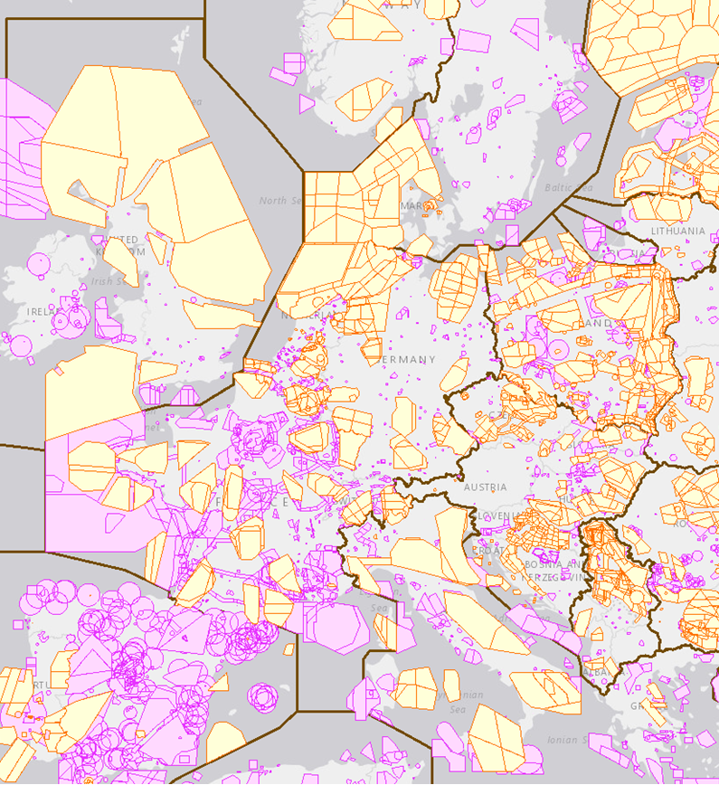
Military requirements and European airspace
Genesis of fragmentation (?)
M. Steinfurth, I. Kuren, R. Lacatus, A. Paulov, V. Somosi

Slide 2
Agenda
Introduction
Airspace as
Scarce
Resource
ATM Policies
Solutions
Conclusions

Slide 3
Introduction
Growing air traffic in congested
European airspace creates challenges for ATM system and airspace organization to mange all demand
Airspace is common resource to be shared
based on commonly agreed principles
Airspace organization, procedures, technology differ
Limited integration and interoperability

Slide 4
Policies
Exclusive sovereignty in the airspace
Performing security, defence, law enforcement operations
Deterrence, defence posture, projecting stability beyond Alliance’s borders
Peacetime missions & crisis response operations require level of readiness achieved by exercises of national air forces
ICAO Convention
NATO doctrines
SES initiative
National policies
Enhance C/M cooperation
Safeguard essential security or defense policy interests
Security, Defence, Disaster Management and Law Enforcement obligations (Air Policing, Airspace Control, Air Defence)

Slide 5
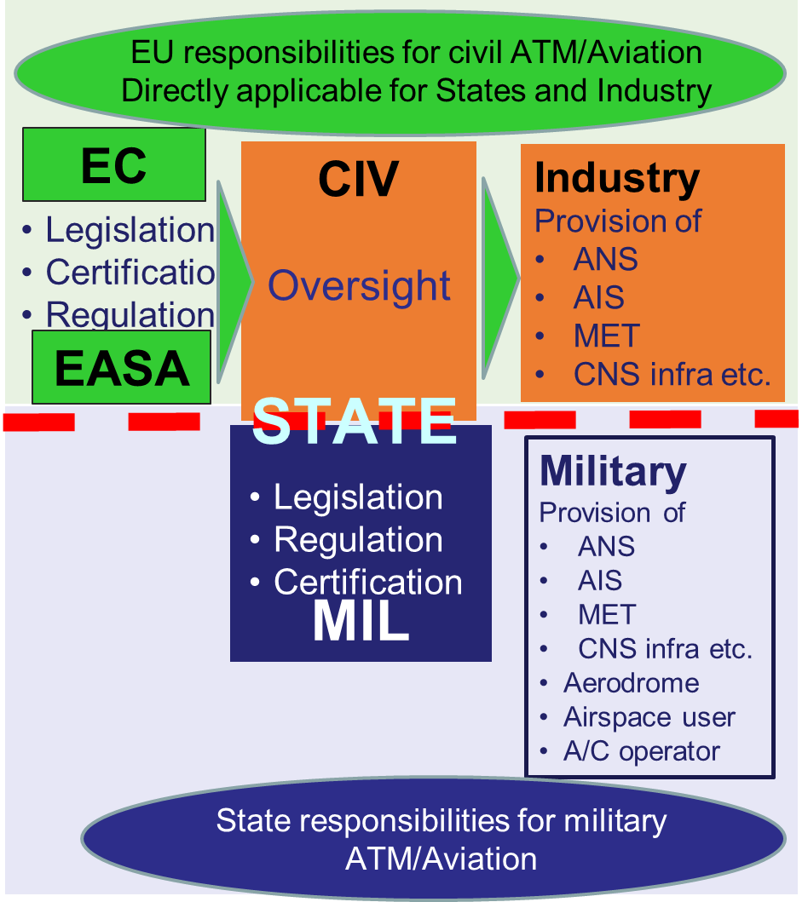
SES principles
Single European Sky
Common declaration on military issues related to SES in EC 549/2004
SES does not apply to the military
Military involved from outset in SES/SESAR
Safeguards to Military training and operations included in multiple IRs
Civil-Military coordination is a SES essential requirement

Slide 6
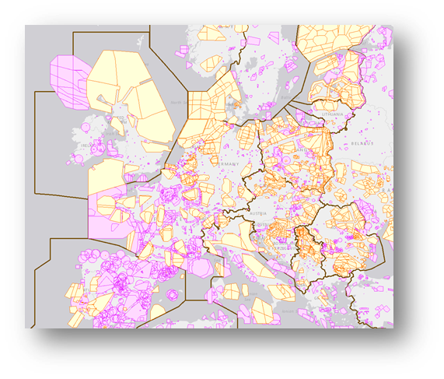

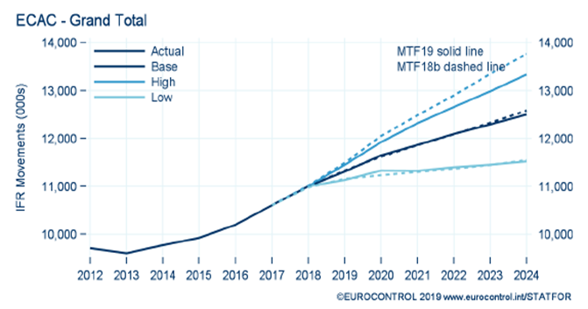
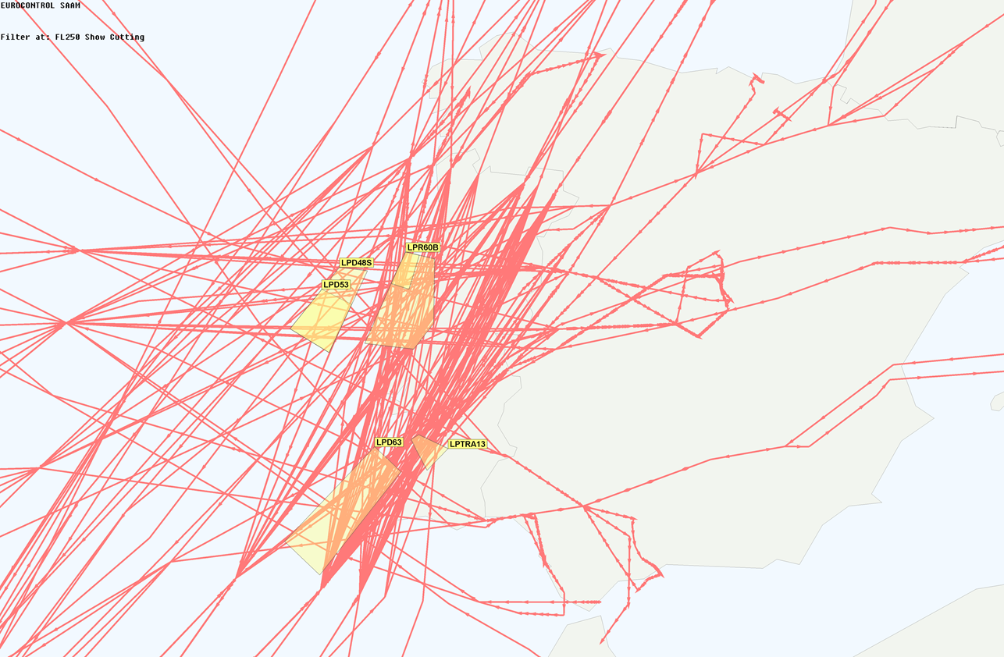
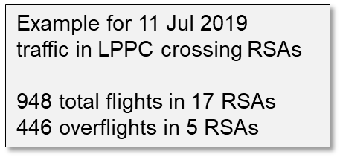
Airspace - scarce resource
Airspace is a common, but limited resource in which civil and military activities must be accommodated by balancing ATM performance needs with security & defence requirements

Slide 7
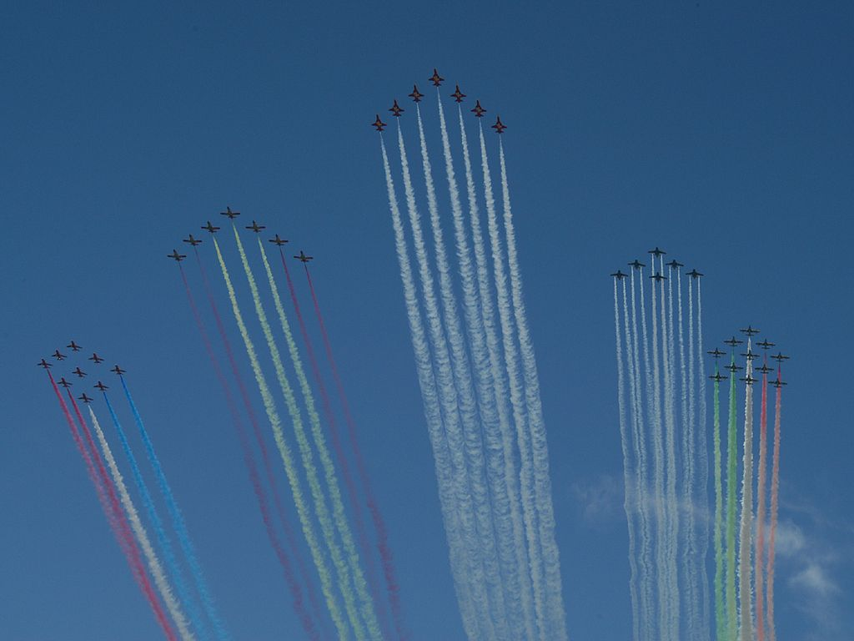
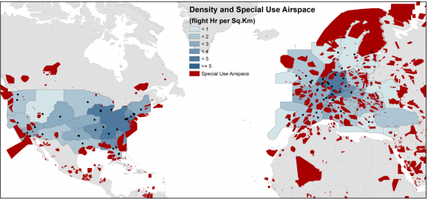
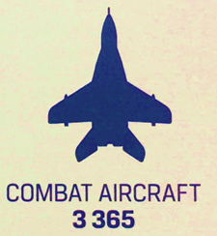
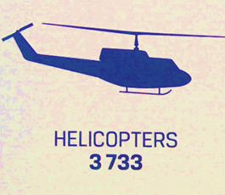
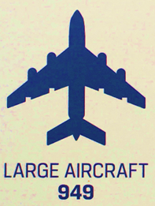
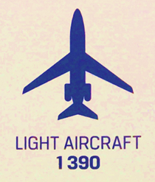
Military Air Power
Roles and Responsibilities in European ATM
  Governmental Regulator
  Service Provider ATS/ATM/CNS
  Military Aircraft Operator
  Airspace User
  National Air Defence Organisation
  Military Certification Agency
National and International Security and Defence
The biggest Aircraft Operator in Europe
  Maintain readiness & capabilities for
    Fight (Deterrence & Defense)
    (Inter)National Airspace Security
    International commitments
    Crisis Management & operations

Slide 8
Solutions (quick wins)
STATES | Provide new airspace design features with increased ARES vertical and latera modularity. Enhance civil-military coordination/collaboration participate in cross-border arrangements
CIVIL AU | Ensure efficient use of the ATM network information in real time through NOP and effective use of the available airspace resource (Fly as planned)
NM | Synchronize ARES allocation and use with traffic flows through DCB Continuously update NOP and ensure consistency of the AU demand through balancing demand of all categories of AU versus available capacity and provision of the real airspace status update
MILITARY AU | Share true demand with ATM actors concerned through improved OAT FPL and engage in CDM when possible (Fly as Planned)
ANSP | Ensure efficient civil-military co-ordination, provide ATS services to all categories of AU
ALL | Collaborate in all phases of the ATM lifecycle to optimize ATM network performance

Slide 9
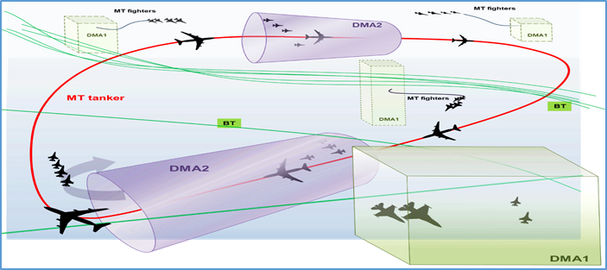
Solutions (long term)

Slide 10
Conclusions
Military operations and training do not constitute a root cause of the fragmentation of European ATM
Security and defence is a shared civil-military responsibility
European ATM defragmentation requires consistent political support and a paradigm shift in ANS provision
To cope with future ATM demands, civil-military coordination shall be underpinned by collaboration in airspace design, planning, and decision-making at local/sub-regional and network levels
Some short-term improvements (quick wins) could enhance EATMN performance without adverse impact on military training and exercise requirements and could lead to long-term measures that will also intensify the military commitment to the on-going strategic developments related to the evolution of the SES

Slide 11
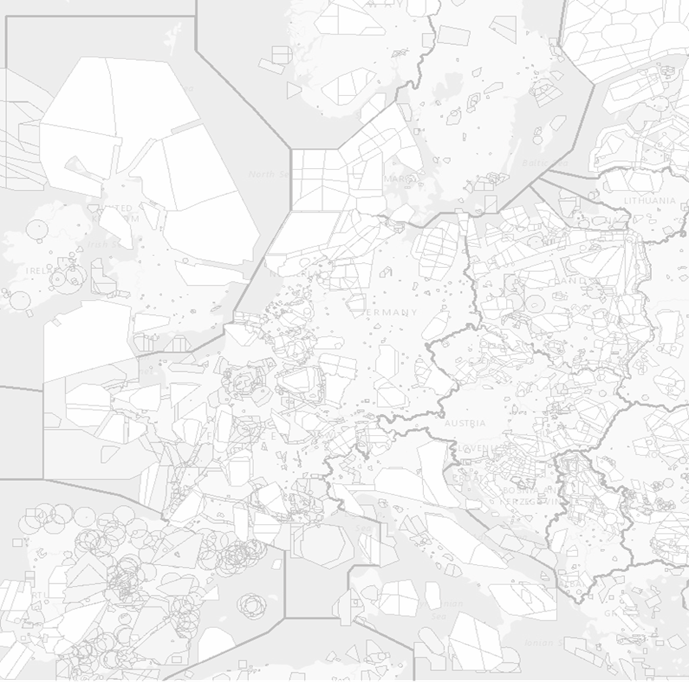
Thank you for your attention!

